Slide 1
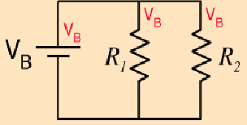
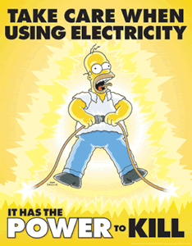
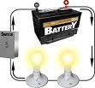
Electric Circuits

Slide 2
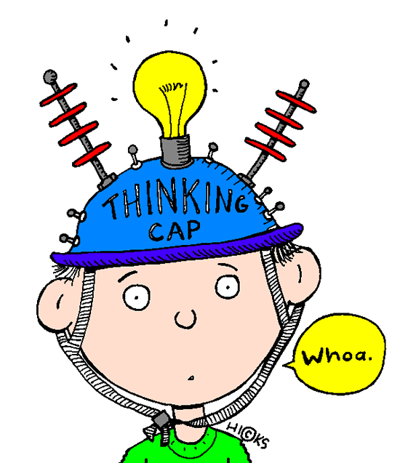
What do you remember?
Term | Definition
____current | Circuit in which elements are connected in line so there is only one path for charges to follow.
____voltage | B. Opposition to the flow of charge.
____load | C. Device which measures electric potential difference.
____switch | The work per unit charge required to move a positive charge between two points in an electric circuit.
____voltmeter | E. Control device in an electric circuit.
____ammeter | F. The rate at which electrical charges flow in a circuit.
____series circuit | G. Circuit in there is more than one path for charges to follow.
____parallel circuit | H. A direct pathway with low resistance connecting two sides of a battery or other electrical source.
____resistance | Device which converts electrical energy into other forms of energy.
____short circuit | J. Device which measures electric current.
____source | K. Device which supplies energy to charges in a circuit.
F
D
I
E
C
J
A
G
B
H
K

Slide 3
Three key components of an electric circuit:
Source: device which provides electrical
energy to the charges in a circuit
e.g battery , power supply
Load : device which converts electrical
energy to another form
e.g. light bulb, motor
Conductor: provides a pathway for current flow
e.g. wire

Slide 4


Circuit Symbols and Diagrams
Symbol | Device | Symbol | Device
 | Cell |  | Resistor
 | Battery |  | Variable Resistor
 | AC Voltage Source |  | Light Bulb
 | DC Voltage Source |  | Motor
 | Switch |  | Ammeter
 | Generator |  | Voltmeter

Slide 5
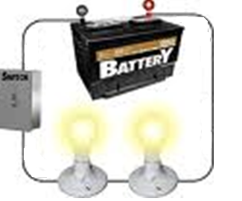




Draw the circuit below and indicate the direction that positive charge (conventional current) would flow:
-
+
Direction of Current Flow:
Conventional Current Flow: -the direction POSITIVE charges flow in a circuit
*Electron Flow: in reality, electrons flow in the opposite direction from the negative terminal

Slide 6
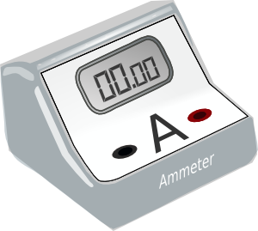
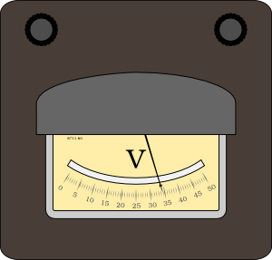
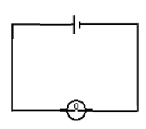
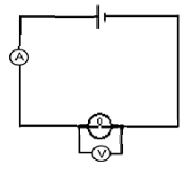
Circuit Measurements
Current:
ammeter
Measured with an __________
connected in line ( in _______) so that current passes directly through the meter.
series
Voltage:
voltmeter
Measured with a __________
connected across the device ( in _________)
parallel

Slide 7
Types of Current
Direct Current (DC): current in which charges flow in one direction
• produced by a battery or DC transformer
Alternating Current (AC): current in which charges change direction periodically
• produced by a wall socket

Slide 8


Circuit Parameters
Current: Symbol: I Units: Ampere (A)
The total charge that passes a point in the circuit in
given time.
A:
B:
Less current
Greater current

Slide 9
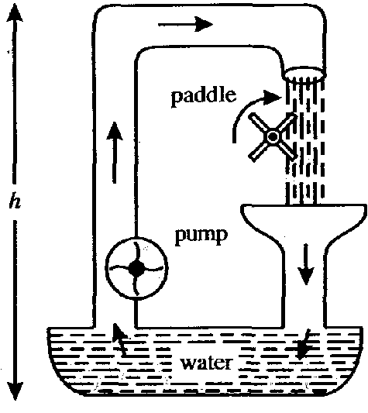
Potential Difference or Voltage (V)
We can compare an electric circuit to a water circuit to understand the concept of potential difference and how a battery works:
Analogy: Battery ≅ Pump
The pump does work on the water to raising it up by Δh and increasing its gravitational potential energy.
Similarly, a battery does work on charges to transfer electrical potential energy to the charges.

Slide 10
Potential Difference, V
Definition: the potential difference between two points in an electric circuit is the work done per unit charge as the charge moves between the two points

Slide 11
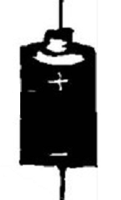
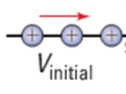

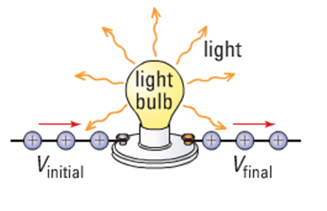
Potential Gain vs. Potential Drop
Gain
Battery: Potential _____
V_{final} > V_{initial}
Drop
Bulb: Potential ______
V_{final} < V_{initial}

